Slide 1

Xmas Data Challenge
Student final dashboards
Trainer: Anh Leimer Training Assistants: Hanna Nguyen, Trang Tran & Hien Tran

Slide 2
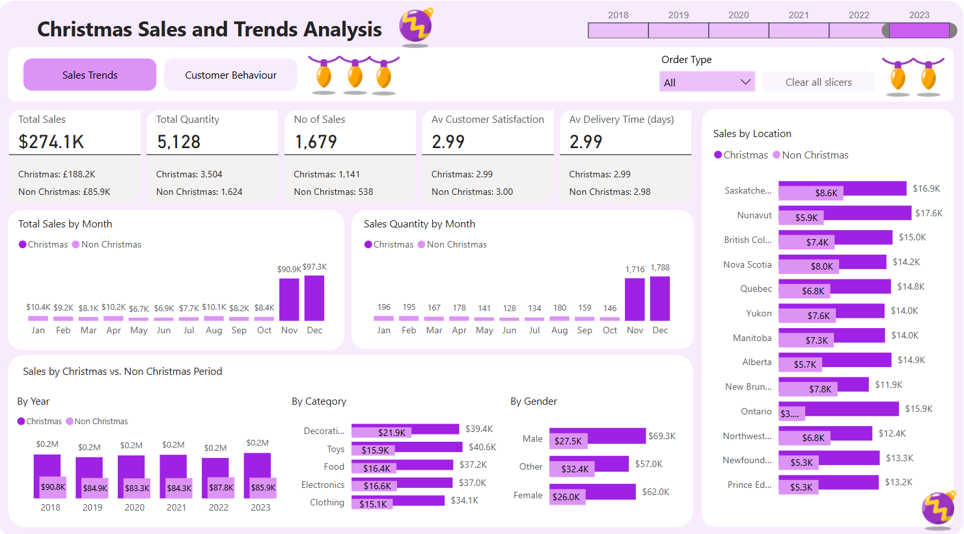
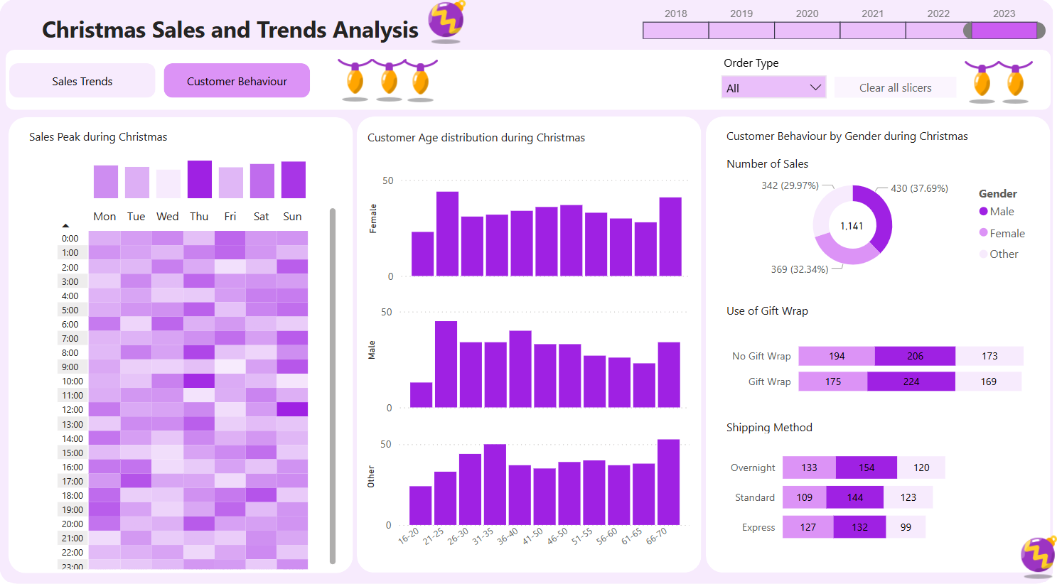
Xmas – FP20 Data Challenge
Link to Linkedin post by Fernanda Goularte

Slide 3
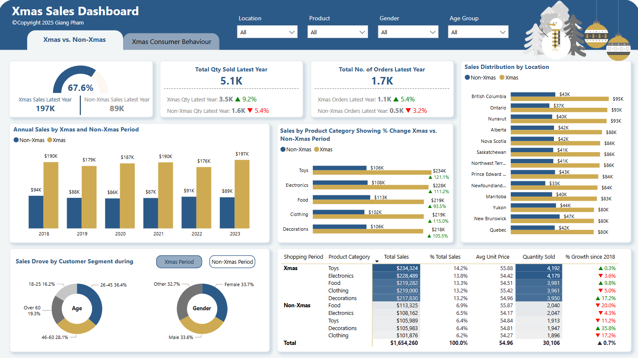
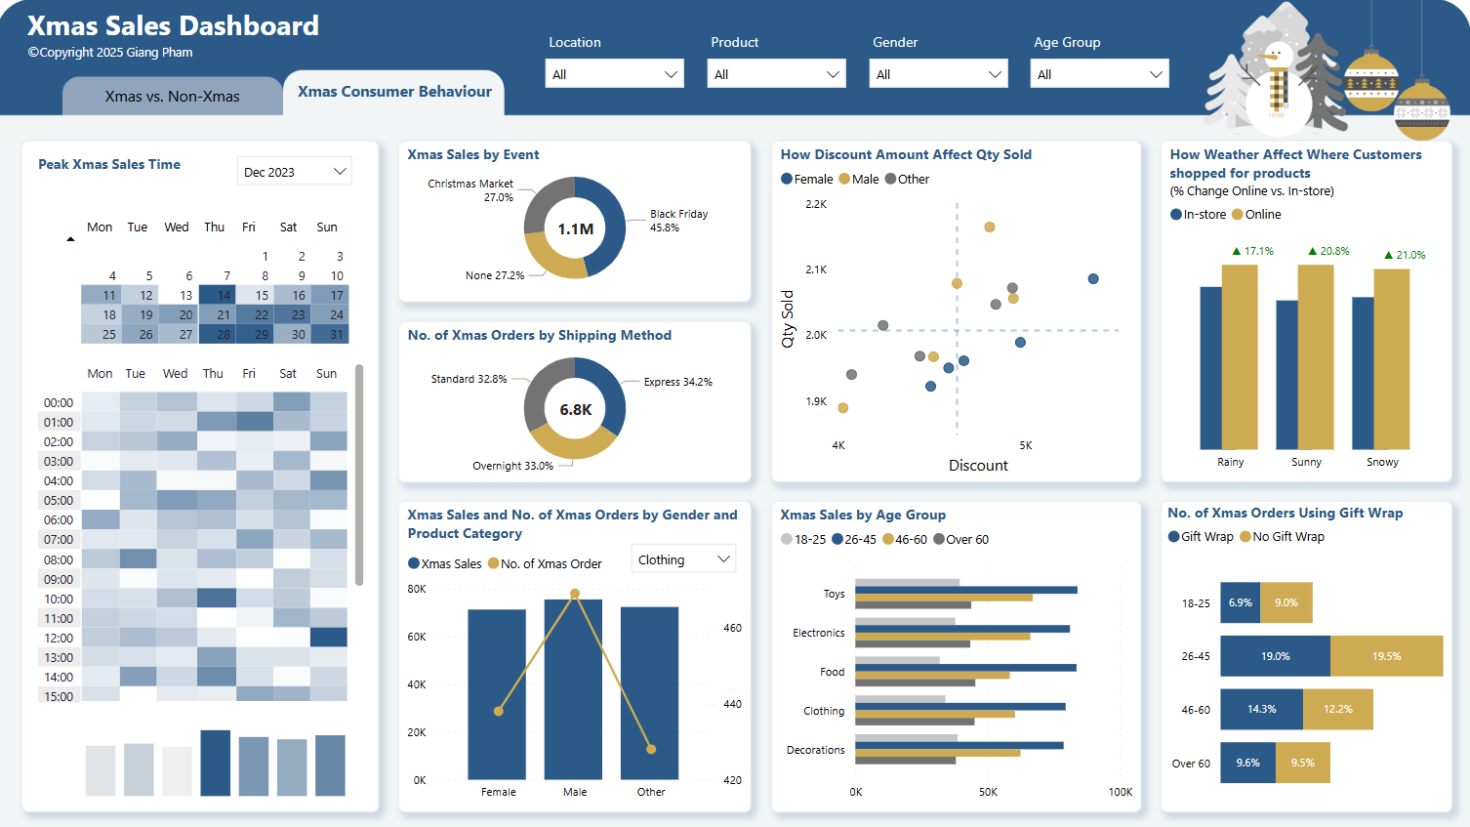
Xmas – FP20 Data Challenge
Link to Linkedin post by Giang Pham

Slide 4
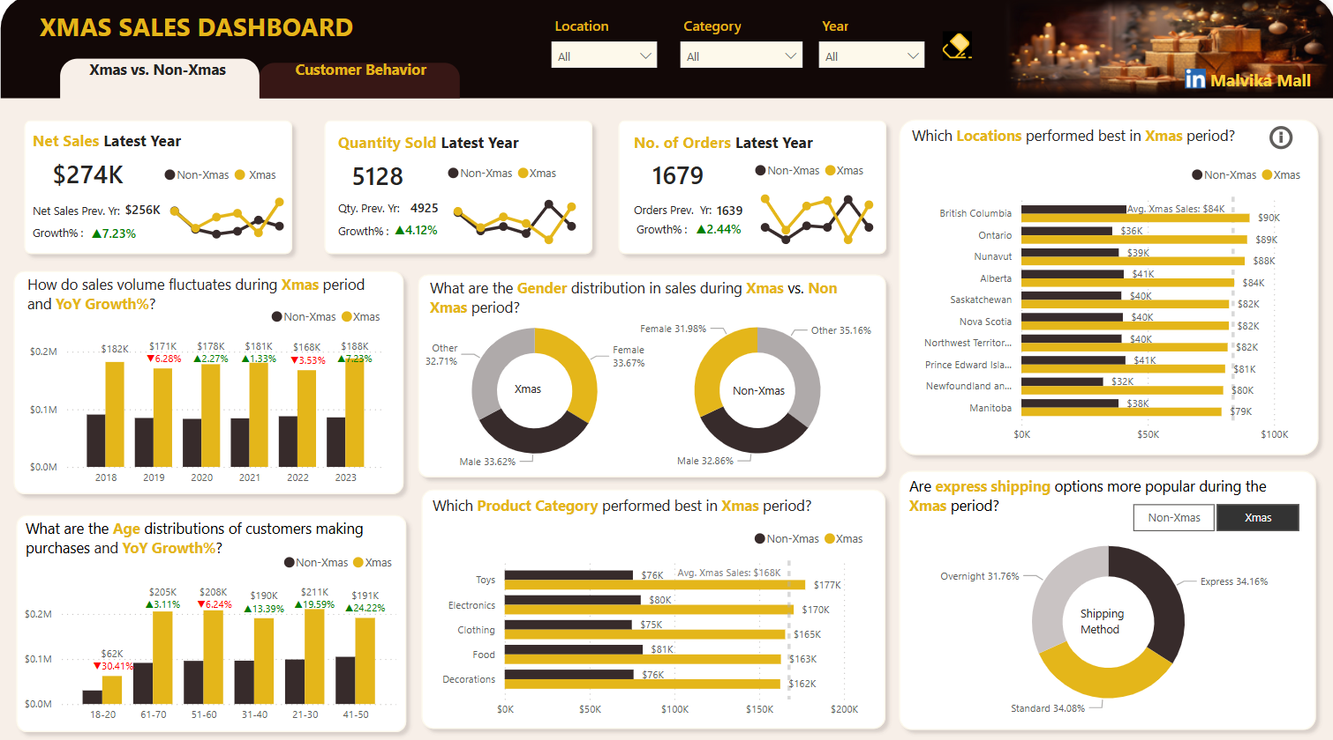
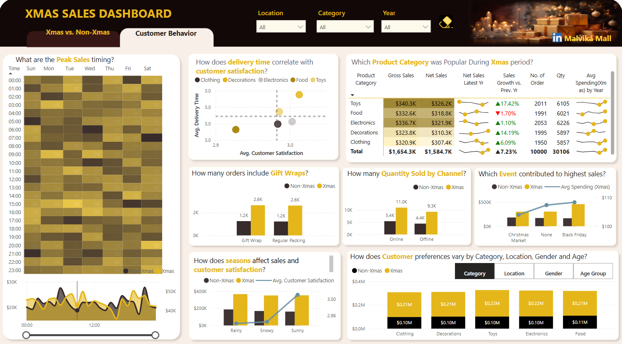
Xmas – FP20 Data Challenge
Link to Linkedin post by Malvika Mall

Slide 5
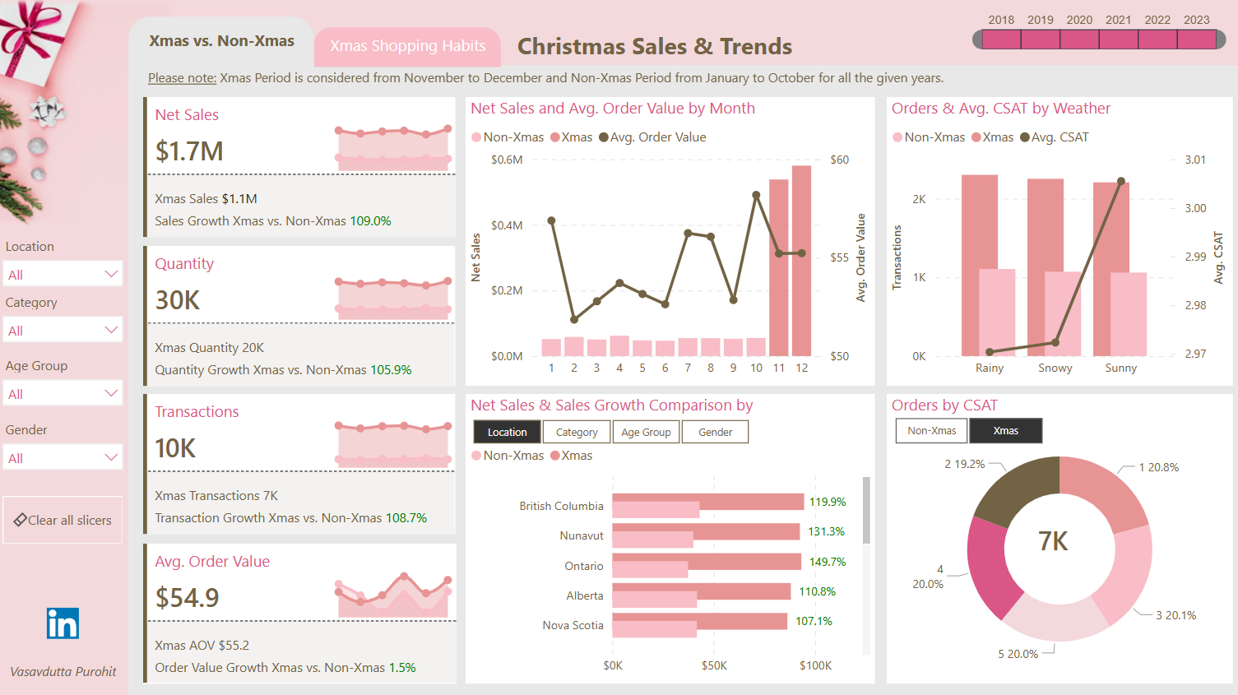
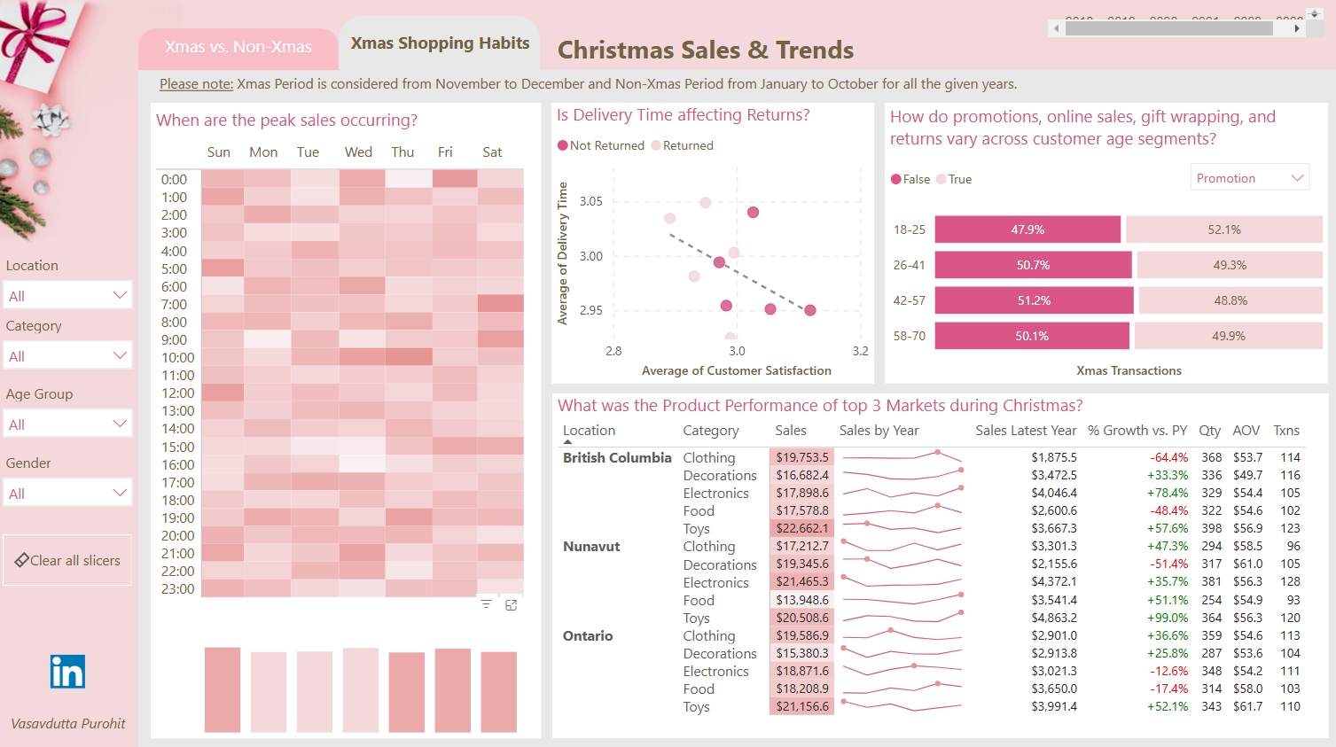
Xmas – FP20 Data Challenge
Link to Linkedin post by Vasavdutta Purohit

Slide 6
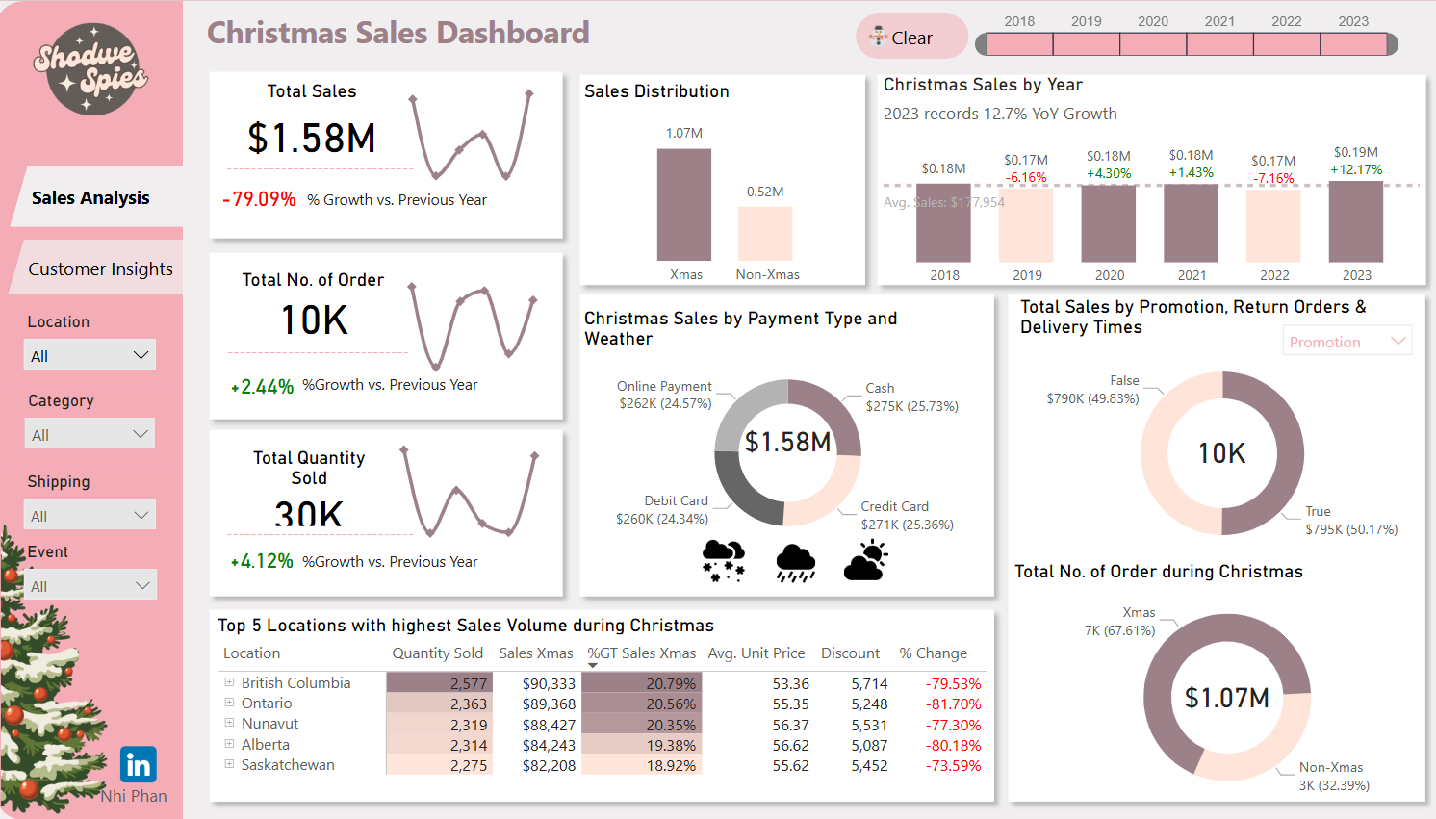
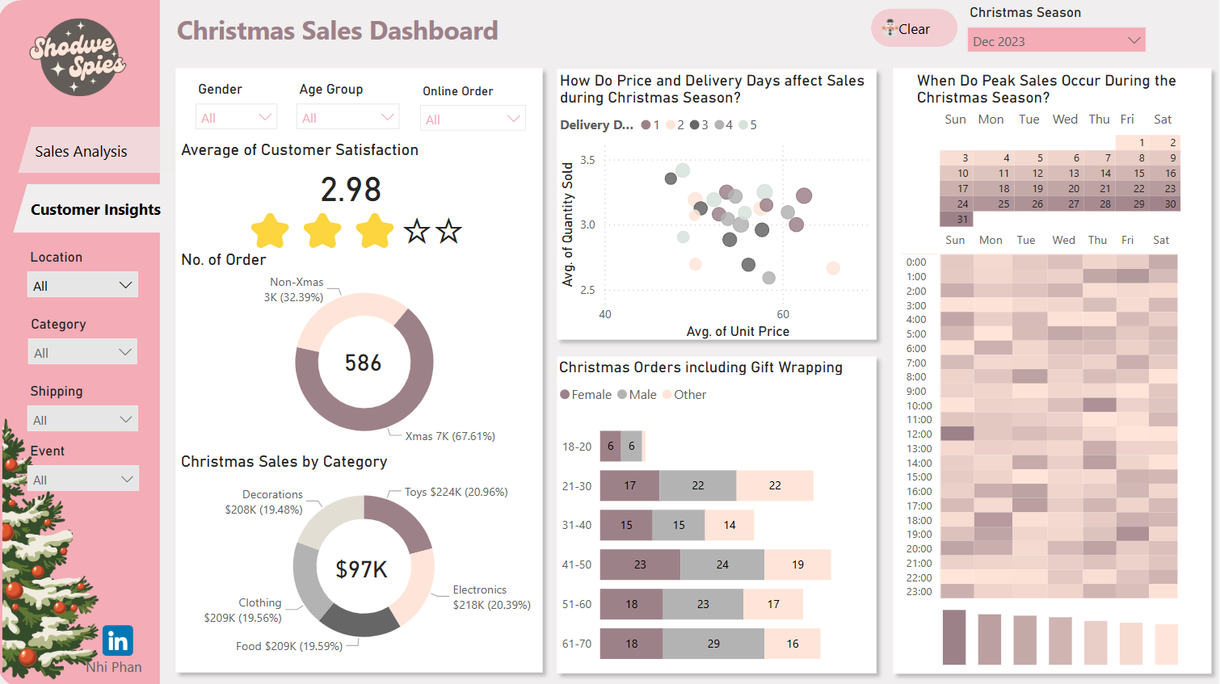
Xmas – FP20 Data Challenge
Link to Linkedin post by Nhi Phan

Slide 7
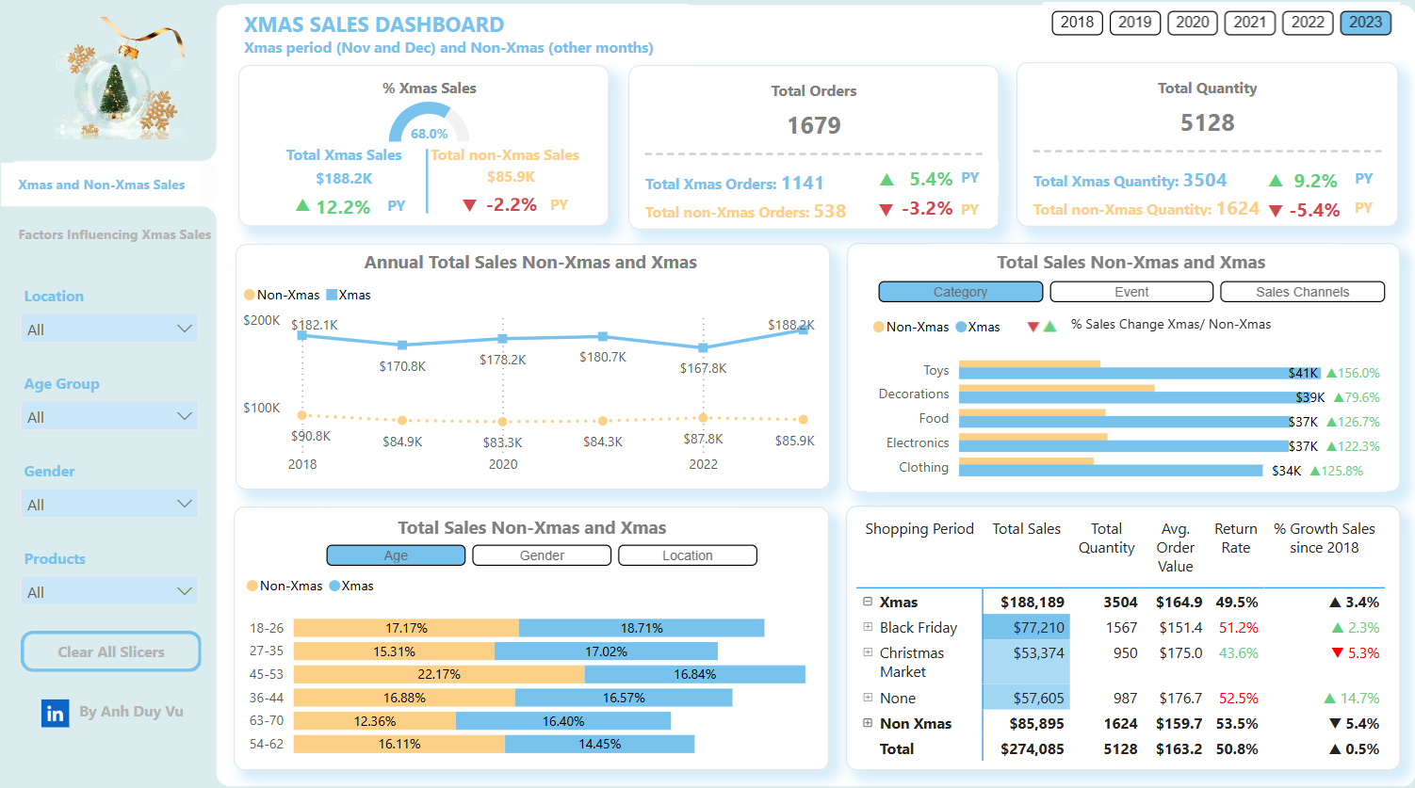
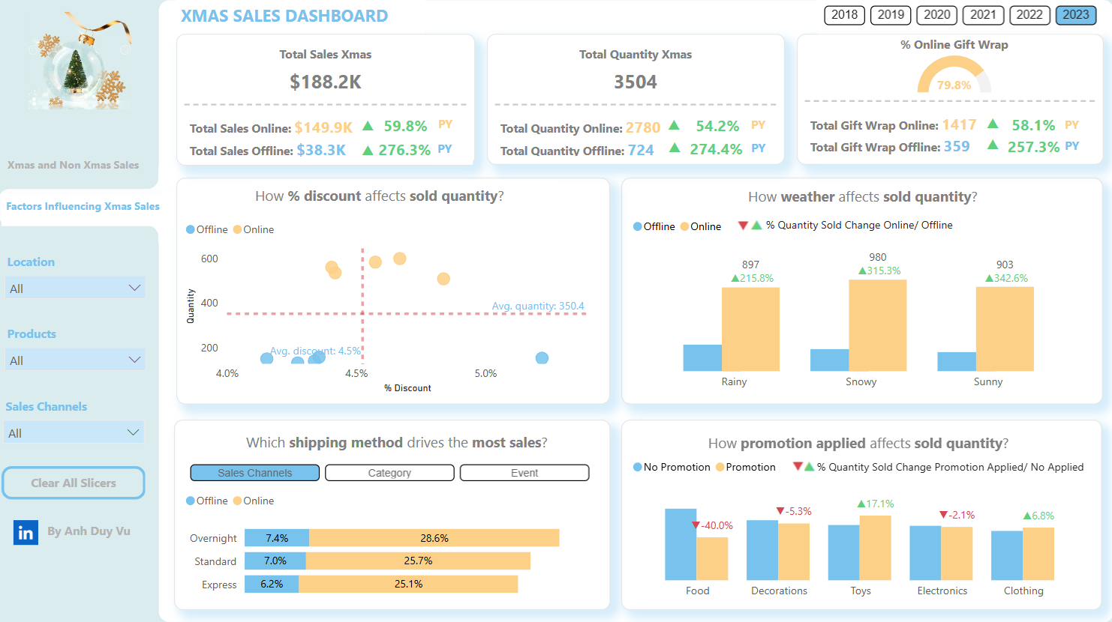
Xmas – FP20 Data Challenge
Link to Linkedin post by Anh Duy Vu

Slide 8
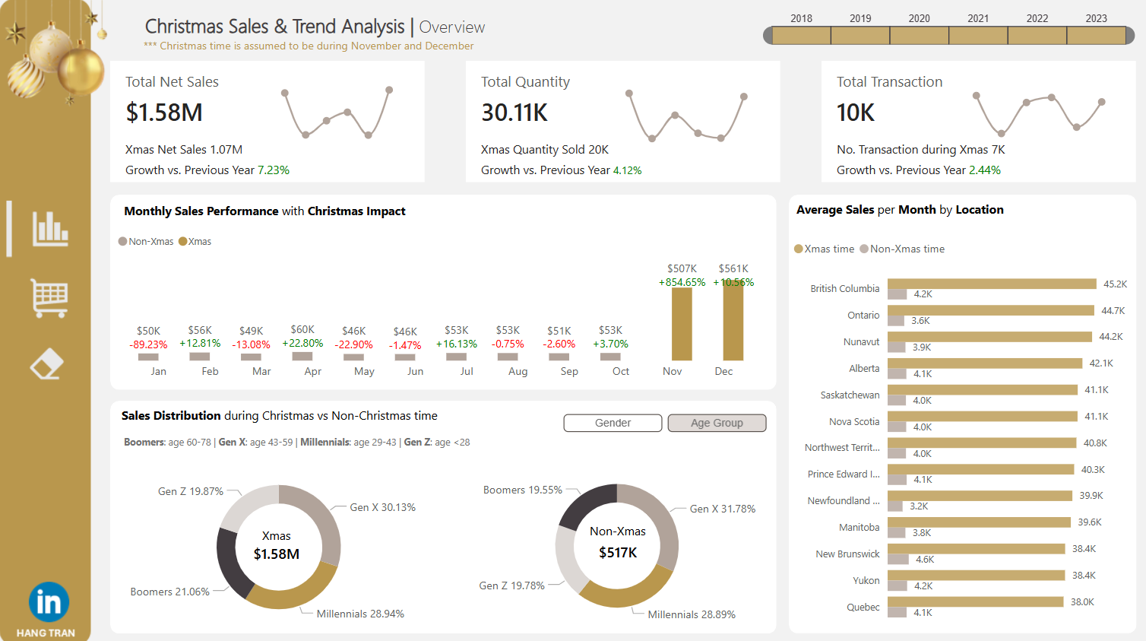
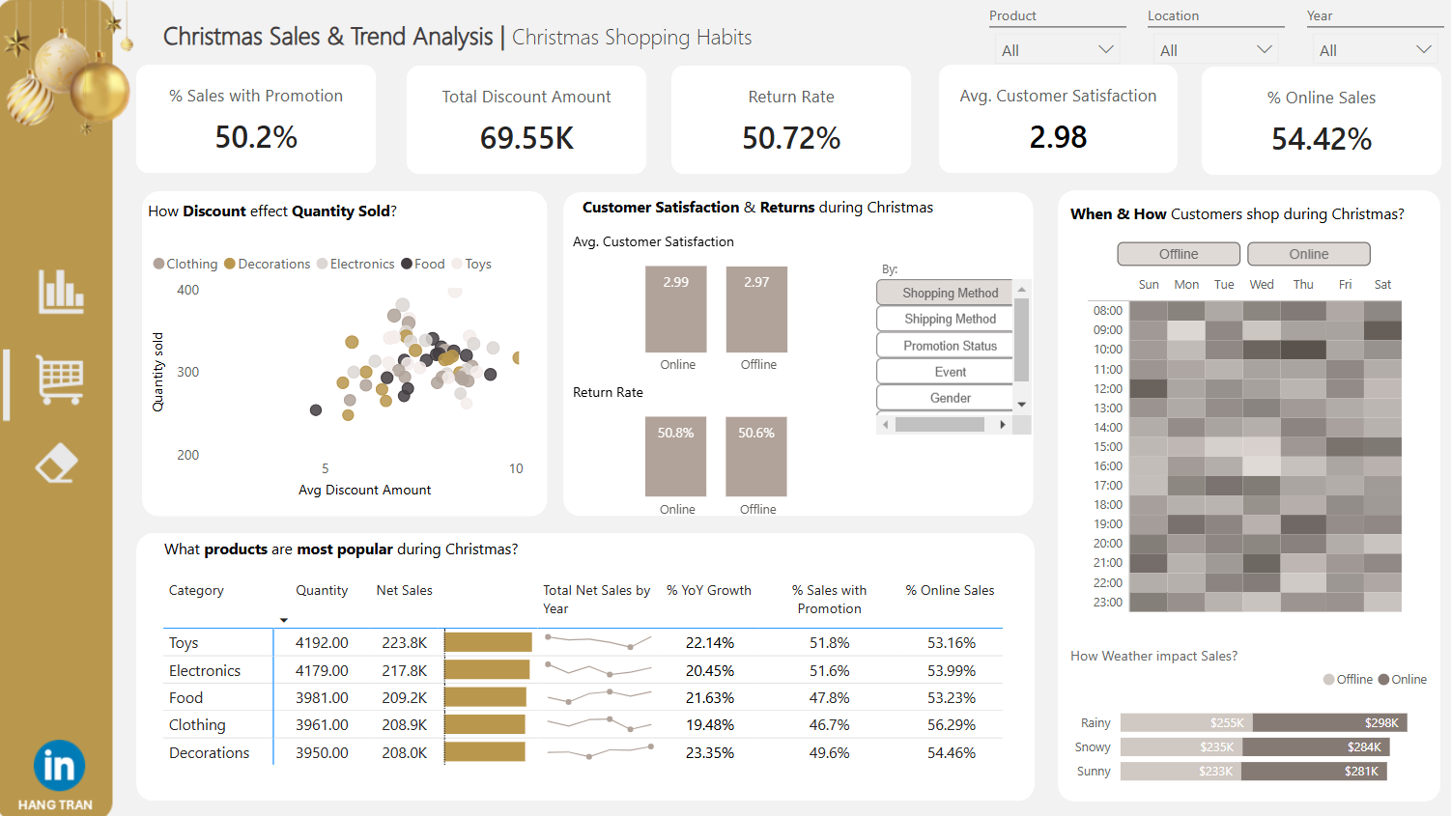
Xmas – FP20 Data Challenge
Link to Linkedin post by Hang Tran

Slide 9
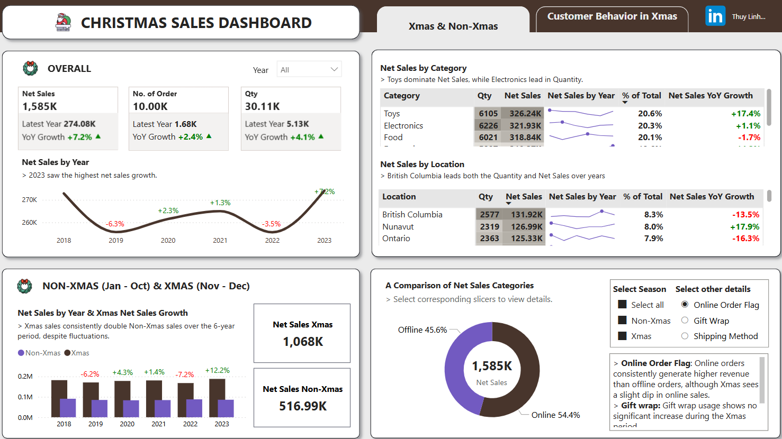
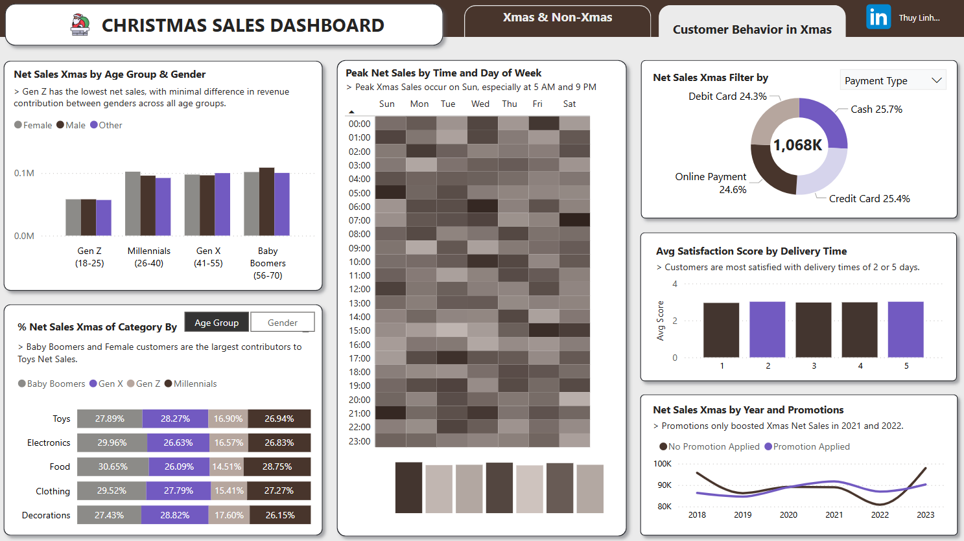
Xmas – FP20 Data Challenge
Link to Linkedin post by Thuy Linh Nguyen

Slide 10
Thank you!
Anh Leimer
Any questions please contact me via:
Email: anh.leimer@gmail.com
Linkedin: Anh Leimer

